Slide 1
Study of Reinforcement Learning using Snake Game
CAPSTONE PROJECT
Pranav Panchal
BrainStation
Notes:
Hello everyone and welcome to the final presentation of my capstone project on study of reinforcement learning using the game of snake

Slide 2
Contents
Objective
What is meant by Reinforcement Learning
Markov Decision Process
Q-Learning
RL Implementation on the Snake Game
Action Plan
Conclusion
Notes:
The flow of todays presentation is as follows:
Firstly introduction
-- followed by What is meant by Reinforcement Learning
-- then understanding the Markov Decision Process
-- knowing what is meant by q-learning
--my implementation of reinforcement learning on a custom snake game
-- future action plans
-- and finally conclusion.

Slide 3
Objective
The objective of this project to create a basic understanding of reinforcement learning by looking at the q-learning method to solve a problem statement
Notes:
The objective of this project to create a basic understanding of reinforcement learning by looking at the q-learning method to solve a problem statement

Slide 4

What is Reinforcement Learning
Notes:
What is reinforcement learning?
Reinforcement learning is.... Ummmmm.........Sorry......... I am sorry guys but I cannot do it....

Slide 5

I’m SORRY!
Notes:
I’m sorry....I cannot go on explaining my capstone to you guys like this.... because its boring!... Well its actually unfair....its unfair to just show you’ll the results and not taking you on the journey.... Lets start from the beginning.....
It all started with an idea...

Slide 6


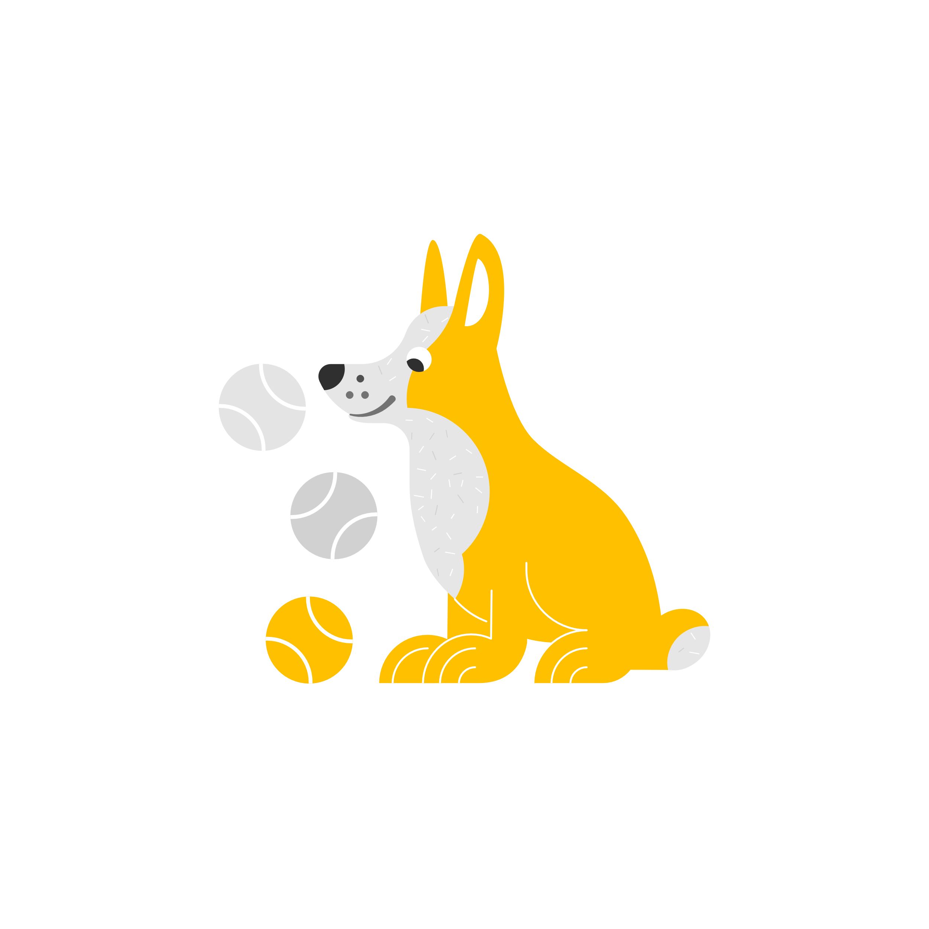
Idea..
What if computers could learn like humans...
or maybe like dogs?
Notes:
An idea... Why were all my project ideas rejected?
Hehehe
But seriously... An idea.... What if computers could learn like humans can... or maybe like dogs.... What if the idea of experiential learning is taken to its max....
It’s a fascinating concept to think about... Maybe for me it started off as a fun project....however, as I think about it more, the more it becomes bizarre

Slide 7





Making a Custom Environment
Notes:
From the start I was determined to build my own environment and apply the RL model on it. To justify it I used an analogy of cars...
Many can drive a car, but fewer can understand how it actually works internally.... How cool would it be if we could build a car and drive it too...
Similarly, I thought it is easier to apply an RL algorithm to a problem and see the results, however it would be more fun to first design the problem to influence and understand model behaviour.

Slide 8

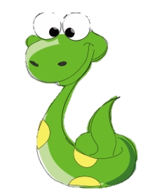


The Design of the Game Environment
+10
ENV
-10
Notes:
The design of the snake game environment is like a regular snake game
The snake is given a reward of +10 whenever it eats the food.
And it is given a penalty of -10 whenever it dies.
However, there is a change…
When we human play the game we look at the food on the game grid and navigate the little snake towards it by hitting the appropriate keys. This is something that the little snake agent cannot do on its own and it requires some help.
The help is provided by the environment...

Slide 9


Observation Space & Action Space
Observation Space
Action Space
Notes:
The environment is designed in such a way that it provides an observation space to the snake... Kind of like a snapshot of things around it....
At any given movement it tells it 3 things
1. whether there is danger around the snake’s head
2. in which direction is the snake moving---- up, down, left, right
3. and the relative food location wrt to the snake head
All this information is coded in Boolean cases and later mapped to intergers and we get and observation space depicted by a tuple of 3 integers...
Based on this information the snake can choose 1 of 3 actions...... Whether to remain going straight, turn left or turn right.

Slide 10
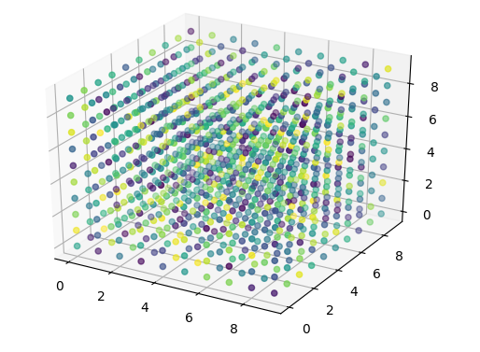

Q-Table
8 x 4 x 8 x 3 = 768
Learning
Notes:
Thus our Q-table for the snake game is 8 times 4 times 8 times 3 big....... That’s around 768 state action pairs....
Some of these state action pairs are more frequent than other.... Some are nearly impossible...
The snake then uses this q table for learning.... It writes in this table during its exploration steps and reads and updates it during the exploitation steps.

Slide 11
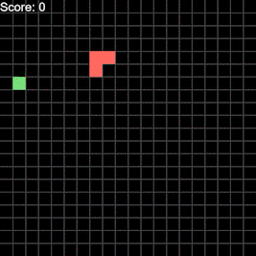
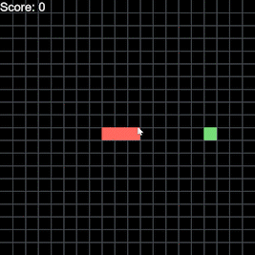
Training
Notes:
Based on this q-table and training the agent for a few thousand episodes, along with adjusting certain training parameters...... Eventually the snake was able to get to the food....

Slide 12
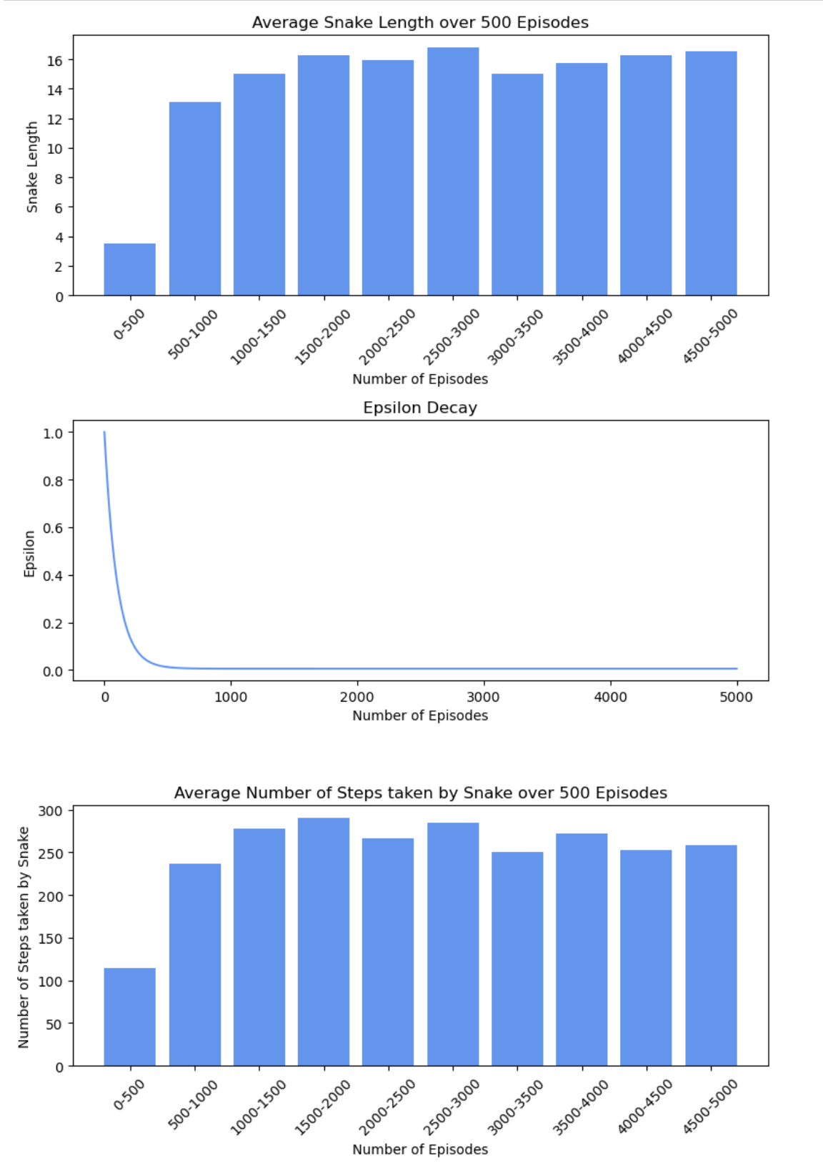
Snake length
Number of game steps
Notes:
These are performance graphs from one such training run...... On the left, we can see that the average length of snake grew from 4 to 16 over a period of 2000 episodes and on the right we se during this time the average number of steps survived by the snake also grew to around 300.

Slide 13
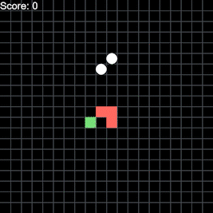
Bonus
Notes:
I modified the snake game environment to make it more advanced... I introduced obstacles which spawned at two random locations on the grid and ran the model trained on the regular game on to this advanced version.... We can notice the snake is trying to avoid the new obstacles...

Slide 14
Road Ahead
- Modify the environment to introduce obstacles and observe whether the model can adapt.
- Modify the reward-penalty parameters and check the behavior of the agent.
- Implement different RL models and compare the results.
Notes:
For future scope we can modify the reward –penalty system and check the behaviour of the snake....
Also the advanced models are there to explore and compare....

Slide 15




Why it matters?
Notes:
Imagine in the near future we humans are able to create the ultimate RL model... A perfect way for computers to perform experiential learning...
Maybe we can give it the problem of solving the traffic congestion of a city
Or we can ask it to provide the optimum distribution chains for vaccines
Or maybe we can ask it to develop the vaccines.... Who knows.... The possibilities might be endless....

Slide 16
Thank You!

Slide 17
Questions?

